Slide 1
We need directional Motes!
… or the next generation of sensor networks.
Warning:
By listening to this talk you may:
change your research area,
become a theoretician,
become a hardware guru.
Listening at your own risk!

Slide 2
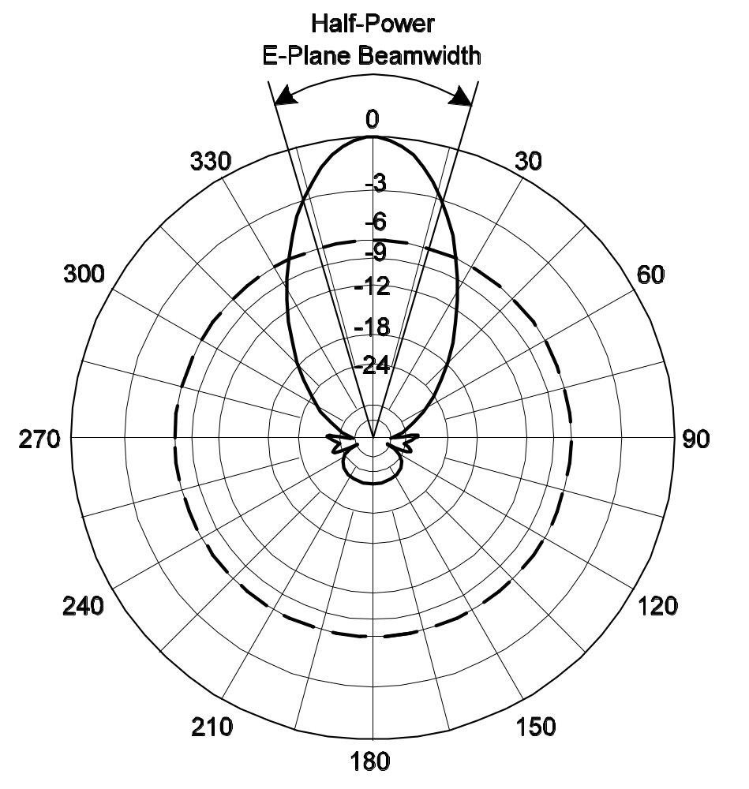

Slide 3
The Theory
Diameter is (roughly) O(√n) in the natural case of n = O(1/r²) (needed to ensure coverage).
Problem: even adding motes does not reduce diameter!
We show that if n = Ω(1/r² log(1/r)) and N = Ω(1/R² log(1/R)) then the diameter is O(1/R+R/r).
If we choose 1/R = √1/r the diameter is reduced from (roughly) √n to n^{1/4} by only adding N ≈ √n directional motes.
Ergo: We need directional motes!

Slide 4
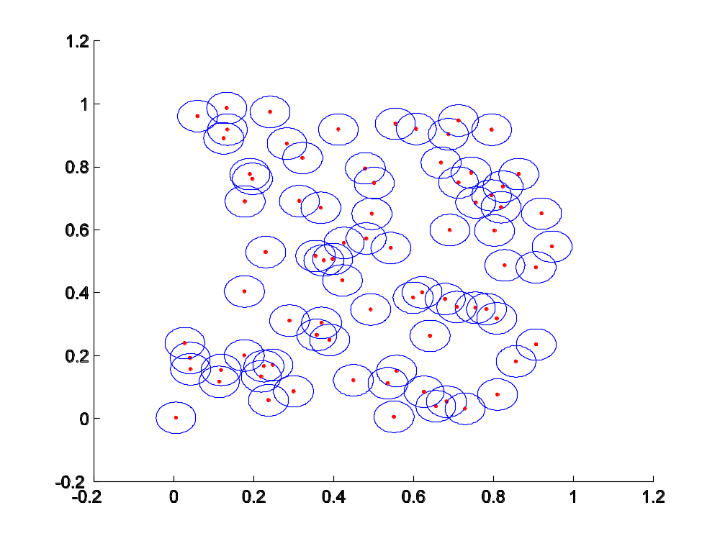
The Praxis

Slide 5
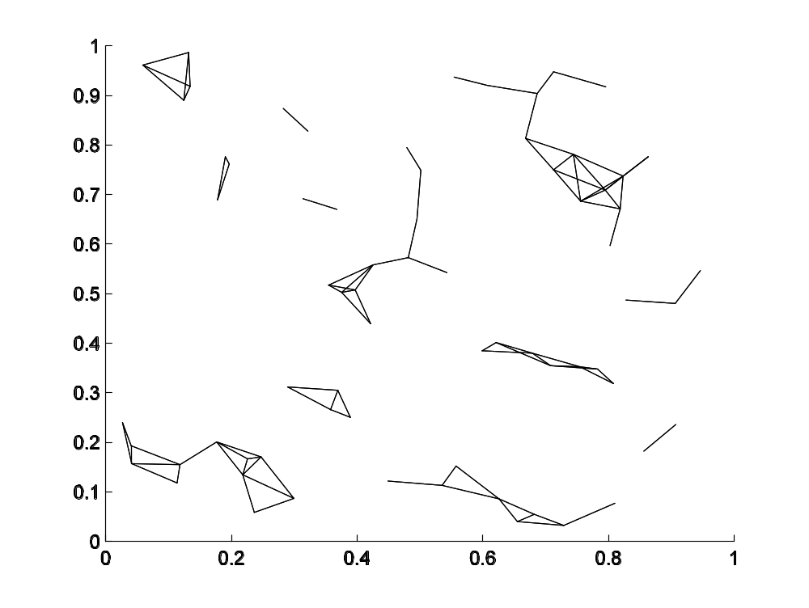

Slide 6
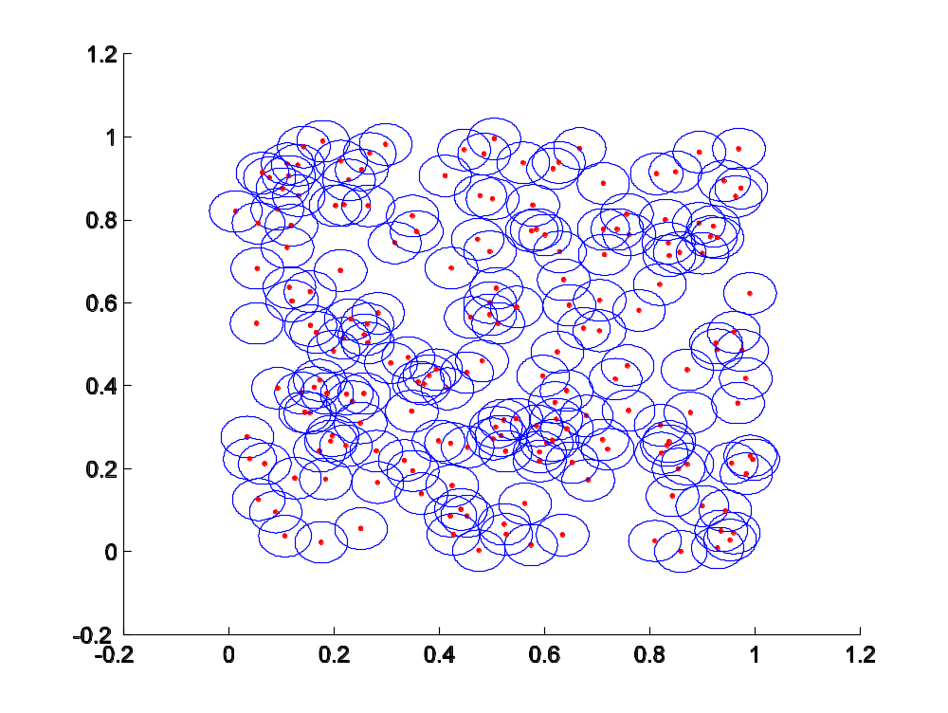

Slide 7
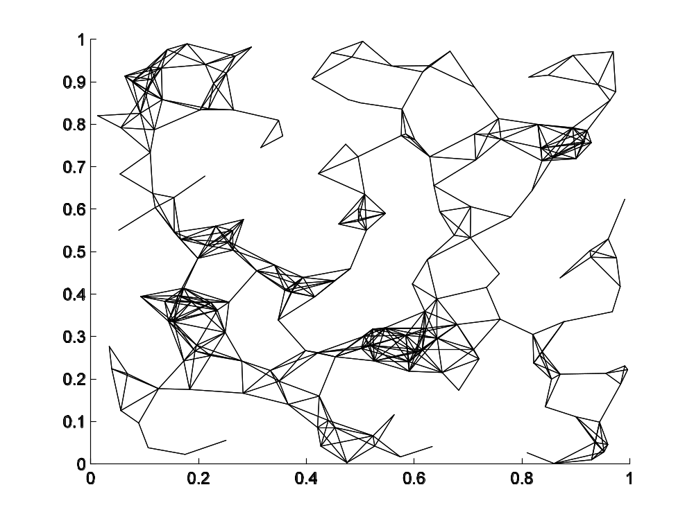

Slide 8
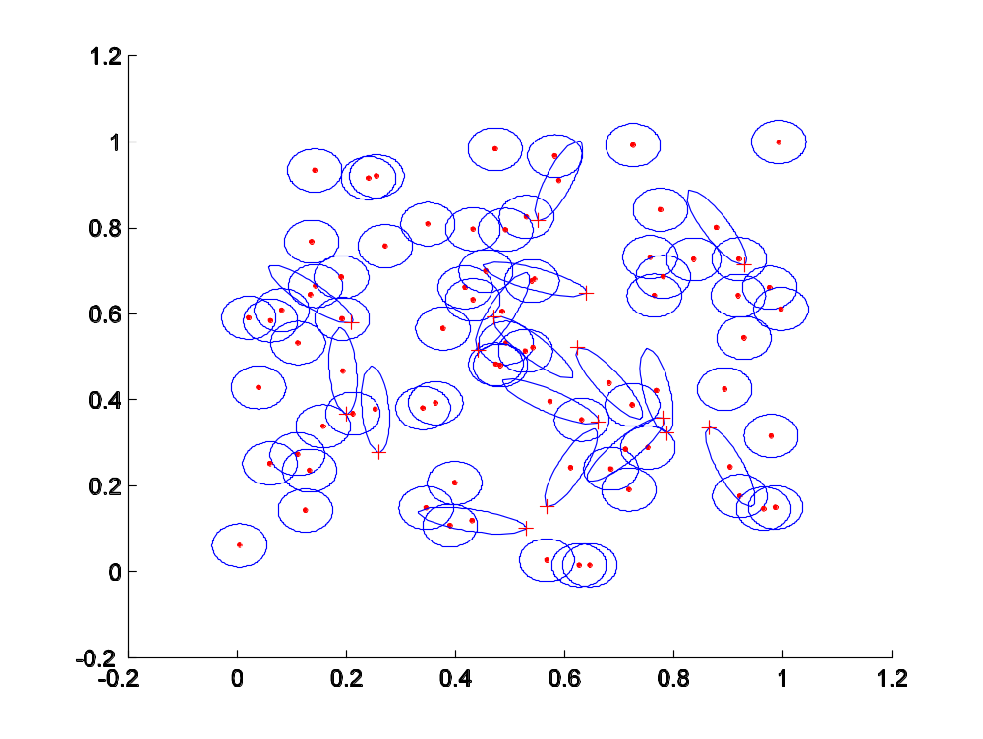

Slide 9
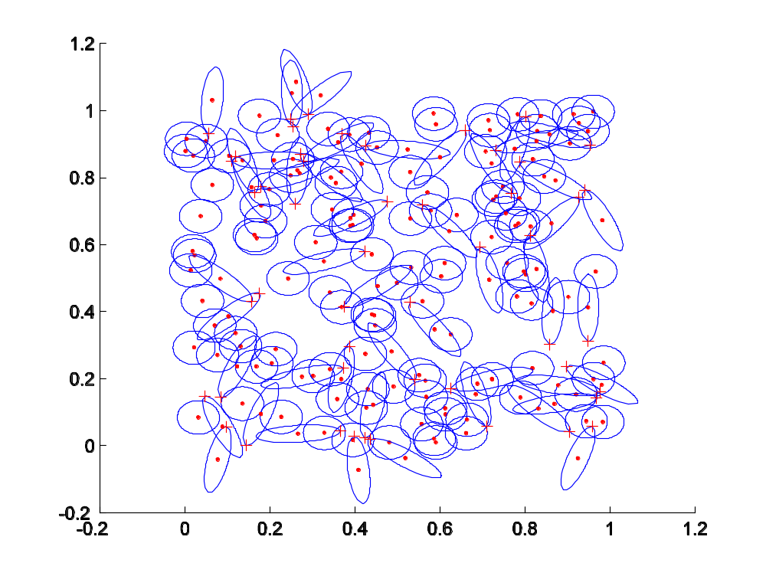

Slide 10
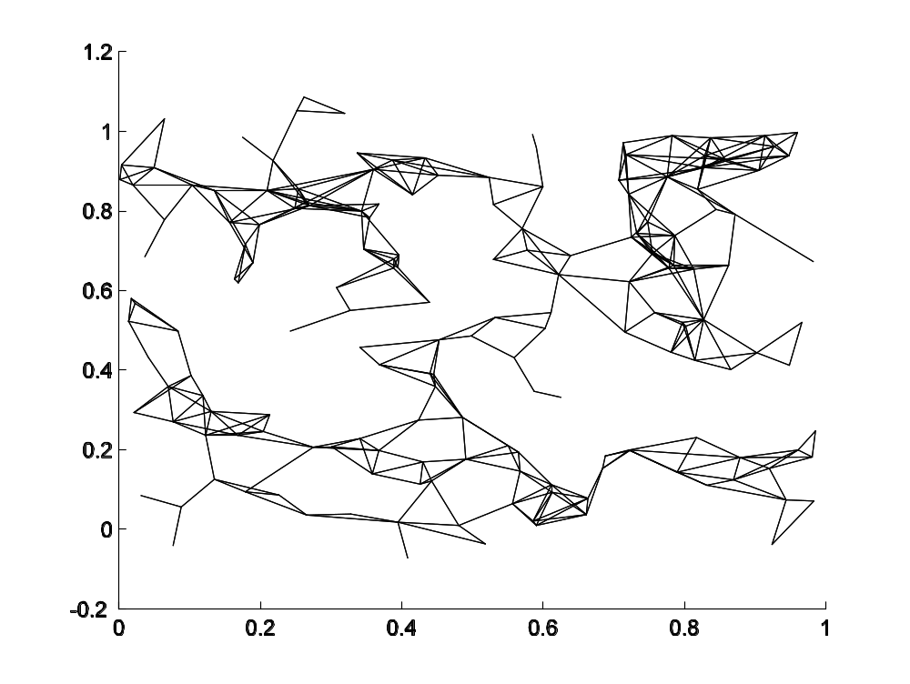

Slide 11
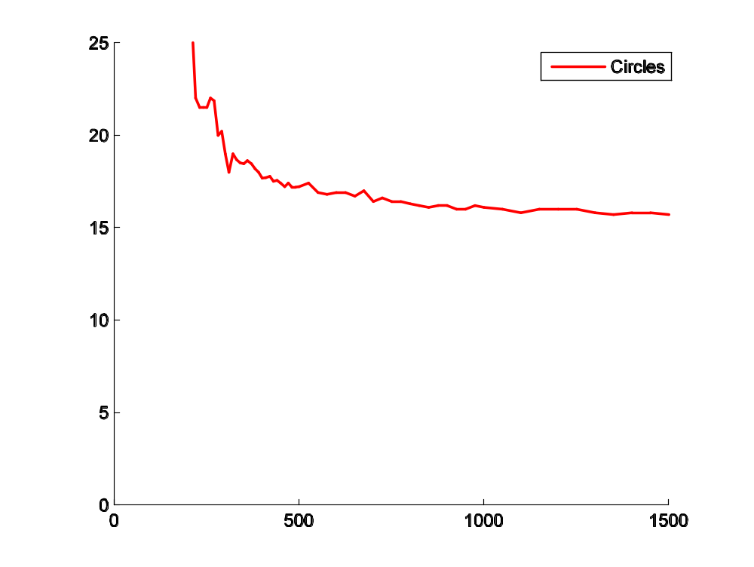

Slide 12
